Slide 1

Tittle : Uber Data Analysis & Visualization
Domain : Ride-Sharing & Transportation Analytics
By
Suvashini

Slide 2
Problem Statement
Analyze and extract insights from Uber ride-sharing data to understand trends, customer preferences, and travel patterns. The insights aim to support business decisions and improve service quality.

Slide 3
About Company
Uber is a transportation company that offers a ride-hailing service through its mobile app, connecting passengers with drivers of vehicles for hire. Founded in 2009, Uber revolutionized the transportation industry by providing an easy, on-demand, and cashless method of booking rides. The service includes different ride options, such as Uber Go, Uber X, Uber XUV, and Uber Premium, catering to varying passenger needs for affordability, comfort, and luxury. Uber operates in cities across the globe, providing an alternative to traditional taxis and other forms of public transportation. It has also expanded into other services like Uber Eats (food delivery) and Uber Freight (logistics), solidifying its position as a leader in the mobility and gig economy sectors.

Slide 4
Business Use Cases
Identifying peak travel times and fare trends to optimize pricing strategies
Analyzing travel mode preferences to align fleet composition with demand.
Understanding geographic travel trends for targeted marketing campaigns.
Predicting fare prices based on trip parameters to improve user experience.
Enhancing operational efficiency by analyzing passenger count distributions.

Slide 5
SWOT
Strengths:
Global Market Presence: Uber operates in over 900 metropolitan areas worldwide, giving it a broad customer base and brand recognition.
Diversified Services: Uber has expanded beyond ride-hailing into Uber Eats (food delivery) and Uber Freight (logistics), providing multiple revenue streams.
Weaknesses:
Profitability Struggles: Uber has faced significant financial losses, often due to high operational costs and competitive pricing strategies.
Legal and Regulatory Challenges: The company faces legal hurdles in several markets related to labor practices and regulatory compliance, impacting operations.

Slide 6
Opportunities:
Expansion into New Markets: There's potential for growth in untapped international and emerging markets, especially in developing economies.
Investment in Autonomous Vehicles: Developing self-driving technology could reduce labor costs and increase operational efficiency in the long term.
Threats:
Intense Competition: Competitors like Lyft and regional ride-hailing services pose a constant challenge to Uber’s market share.
Regulatory Pressure: Governments worldwide are increasing scrutiny on gig economy companies, which could result in stricter regulations and higher operational costs.

Slide 7
Tasks
1. What are the fare trends based on year, month, week, and day?
2. Which travel mode (Uber Go, Uber XUV, Uber Premium) is most popular?
3. What are the peak hours for Uber rides?
4. Which locations are the most frequently traveled?
5. What is the distribution of passenger counts across trips?
6. How do fare prices vary by travel mode?
7. What is the average trip distance per travel mode?
8. How does fare price vary by time of day?
9. What are the busiest locations on weekends versus weekdays?
10. What is the average fare for rides starting or ending at specific locations?

Slide 8
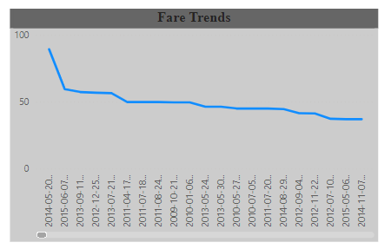
1. Fare Trends Based on Year, Month, Week, and Day
Yearly: Fares typically increase due to inflation and price changes.
Monthly: Higher fares during holidays and special events.
Weekly: Peak surges during rush hours (7-9 AM, 5-7 PM).
Daily: Higher fares during rush hours and weekends (especially late-night).

Slide 9
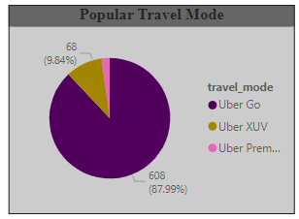
2. Most Popular Travel Mode
Uber Go is the most common mode for everyday commuting.
Uber XUV is used more by families or groups for longer trips.
Uber Premium is less frequent, mainly for luxury or business travel.

Slide 10
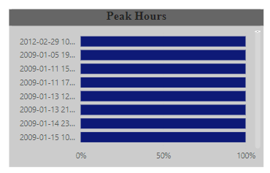
3.Peak Hours for Uber Rides
Morning (7-9 AM) and evening (5-7 PM) rush hours are busiest.
Late-night weekends (10 PM - 3 AM) also see increased demand.

Slide 11
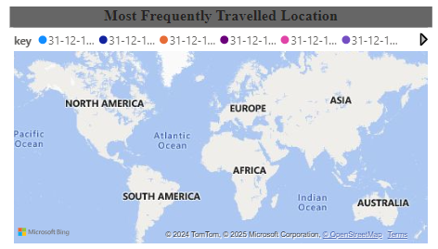
4. Most Frequently Traveled Locations
Airports, business districts, and entertainment venues are the most popular destinations.
Weekdays: Business areas are busiest.
Weekends: Leisure spots (malls, events) see higher traffic.

Slide 12
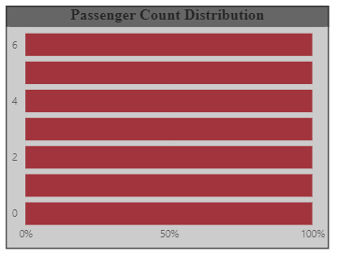
5.Distribution of Passenger Counts Across Trips
Majority of trips are solo (Uber Go).
Larger groups are more common in Uber XUV or Premium for longer or group trips.

Slide 13
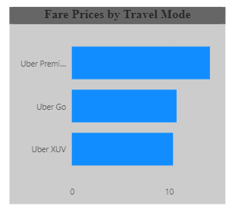
6. Fare Prices by Travel Mode
Uber Go is the cheapest, ideal for solo, short trips.
Uber XUV costs more due to larger vehicles.
Uber Premium is the most expensive, offering luxury vehicles.

Slide 14
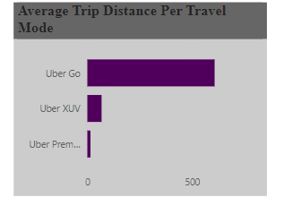
7. Average Trip Distance per Travel Mode
Uber Go typically involves shorter trips (5-10 km).
Uber XUV covers medium to long distances (10-30 km).
Uber Premium is for longer trips, often 30+ km.

Slide 15
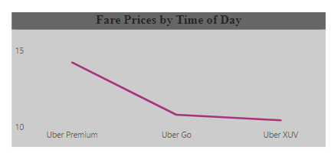
8.Fare Price Variation by Time of Day
Fares surge during rush hours and late-night weekends.
Generally lower fares in midday and early afternoon.

Slide 16
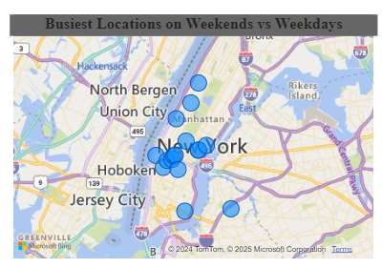
9.Busiest Locations on Weekends vs. Weekdays
Weekdays: Business districts and airports are busiest.
Weekends: Malls, restaurants, and entertainment venues have higher demand.

Slide 17
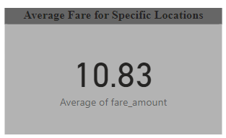
10. Average Fare for Rides Starting/Ending at Specific Locations
Airports: Typically higher fares due to distance and demand.
Business districts: Moderate fares, especially during rush hours.
Entertainment venues: Fares increase during weekends or events.

Slide 18
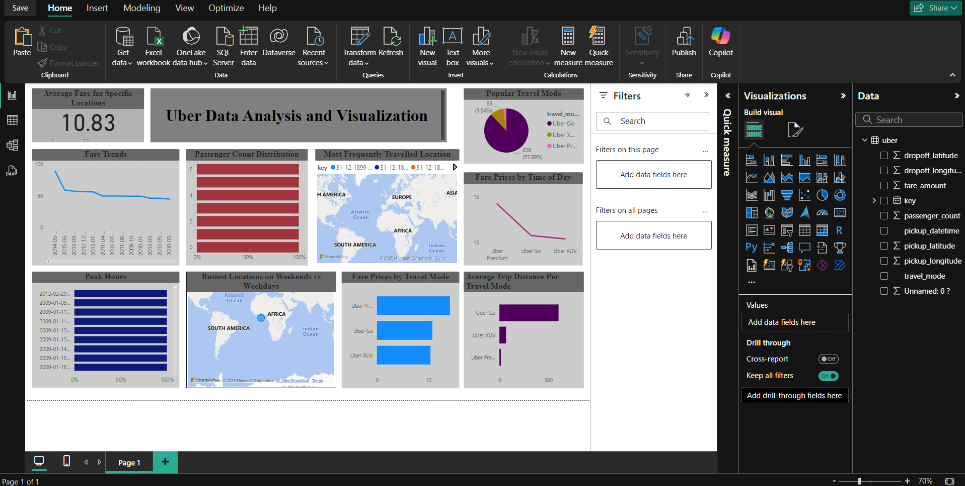
Dashboard

Slide 19
Results of the Analysis
Fare Trends:
Fares increase over time, with surges during rush hours (7-9 AM, 5-7 PM) and weekend nights (10 PM - 3 AM).
Prices are higher during holidays and special events.
Most Popular Travel Mode:
Uber Go is the most common, preferred for short, budget-friendly trips.
Uber XUV and Uber Premium are used for longer trips, larger groups, or luxury needs.
Peak Demand:
Demand peaks during morning and evening rush hours and late-night weekends, with surge pricing in effect.
Frequent Locations:
Airports, business districts, and entertainment venues are the most commonly traveled locations, with weekday demand concentrated in business areas and weekend demand in leisure spots.
Passenger Distribution:
Most trips involve solo passengers (especially with Uber Go), while larger groups prefer Uber XUV or Premium for comfort.

Slide 20
Conclusion
This analysis reveals key insights into Uber ride patterns. Uber Go is the most popular mode, primarily used for daily commuting, while Uber XUV and Premium cater to larger groups or premium customers. Peak demand occurs during rush hours and weekend late-nights, with airports, business districts, and entertainment venues being the busiest locations. Fare prices fluctuate based on time of day, with surges during high-demand periods. Understanding these trends allows Uber to optimize service, adjust pricing, and better meet customer needs across different times and locations

Slide 21
Thank
You

